Slide 1
Windows Driver Examples
Basic examples about drivers in the Windows operating system.

Slide 2
Windows Driver Basics
HelloWorld
Example 2 Part1(Together)
Example 2 Part2(Together)
Example 2 Part3(Together)

Slide 3
HelloWorld Example

Slide 4
Example 2
Part I

Slide 5
<ntddk.h>

Slide 6
Registry
HKLM\System\CurrentControlSet\Services\ServiceName o Nombre del driver

Slide 7
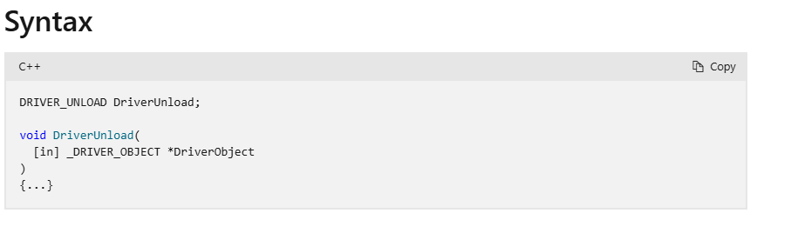
Unload Routine

Slide 8
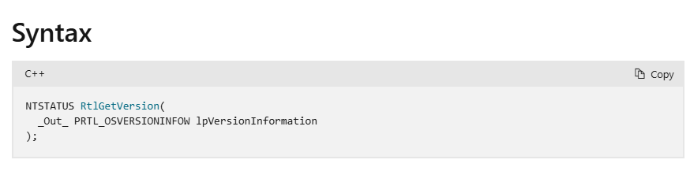
OS Version

Slide 9
Start Value
0x00000000
0x00000001
0x00000002
0x00000003
0x00000004
Boot
System
Automatic
OnDemand
Disabled

Slide 10
Semana 4

Slide 11
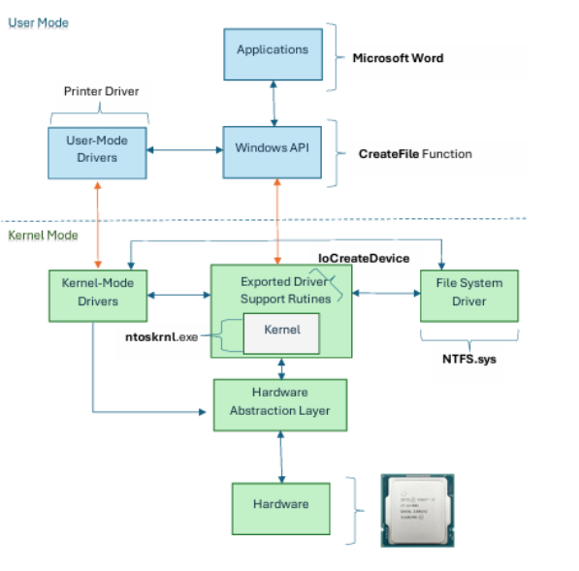
ntoskrnl.exe

Slide 12
Example 2
Part II

Slide 13
Dispatch Routines
IRP_MJ_CREATE
IRP_MJ_CLOSE
IRP_MJ_DEVICE_CONTROL
User Mode
Kernel Mode
User Mode
Kernel Mode
CreateFile
ZwCreateFile
CloseHandle
ZwClose
User Mode
Kernel Mode
DeviceIoControl
ZwDeviceIoControlFile

Slide 14
Dispatch Routines
Driver Object
IPR_MJ_CREATE
MajorFunction[IRP_MJ_…]
IPR_MJ_CLOSE
IPR_MJ_DEVICE_CONTROL
DRIVER_OBJECT

Slide 15

Prototype: Dispatch Routine

Slide 16
How do we communicate with the driver?
DRIVER_OBJECT
DEVICE_OBJECT
NULL

Slide 17
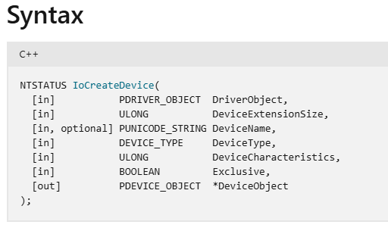
Device Object

Slide 18
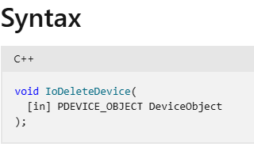
IoDeleteDevice
Driver Object
Device Object
DeviceObject
NULL
DEVICE_OBJECT
DRIVER_OBJECT

Slide 19
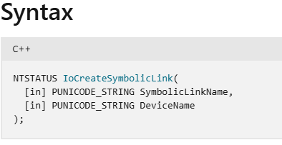
Device Symbolic Link
IoCreateSymbolicLink

Slide 20
Example 2
Part III

Slide 21
IRP
A structure representing any type of request.
Contains all the information related to the request: codes, sizes, buffers, etc.
Created by:
I/O Manager: Create, Close, Read, Write
P&P Manager: Plug and Play operations
Power Manager: Power operations
IRP Structure
IRP Structure
MdlAddress
AssociatedIrp
Current I/O Stack Location
I/O Stack Locations Count
IoStatus
IoStatus
User Event
IO_STATUS_BLOCK
Status
User Buffer
Information
…

Slide 22
I/O Stack Location
IRP Structure
IO_STACK_LOCATION
MdlAddress
Major Function
Minor Function
Create
Parameters
AssociatedIrp
Read
Current I/O Stack Location
FileObject
Write
DeviceObject
I/O Stack Locations Count
CompletionRoutine
DeviceIoControl
IoStatus
Context
Power
User Event
StartDevice
User Buffer
Cancel Routine
IO_STACK_LOCATION
…

Slide 23
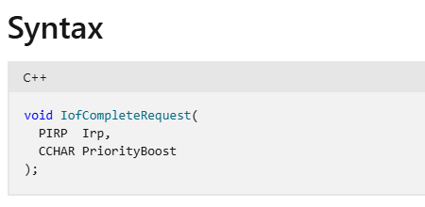
Completing a Request

Slide 24
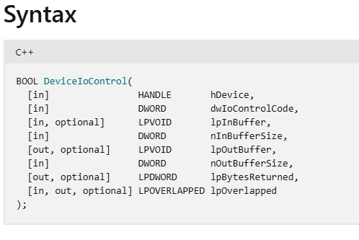
DeviceIoControl

Slide 25
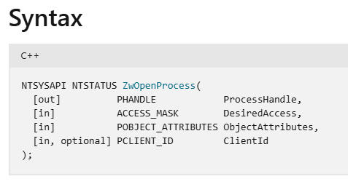
ZwOpenProcess

Slide 26
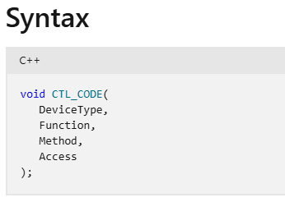
CTL_CODE

Slide 27
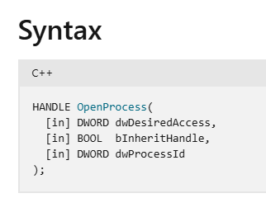
OpenProcess

Slide 28
Windows Driver Examples
Windows Driver Basics
Basic examples about drivers in the Windows operating system.

